Slide 1
A) How do you say “galleta” in english? B) “cookie” A) How do you spell it? B) C – 0 – O – K –I –E-

Slide 2
How do you say “PAN” in english?
“BREAD”
How do you spell it?
B – R – E – A –D

Slide 3
How do you say “CANELA” in english?
“CINNAMON”
How do you spell it?
C – I – N – N - A –M – O - N

Slide 4
How do you say “ABEJA” in english?
“BEE”
How do you spell it?
B – E – E

Slide 5
A )How do you say “_______” in english? (WORD IN SPANISH)
“
B) “______________”
(WORD IN ENGLISH
A) How do you spell it?
B) (You spell here: __ __ __ __ __ __ __ __ )

Slide 6

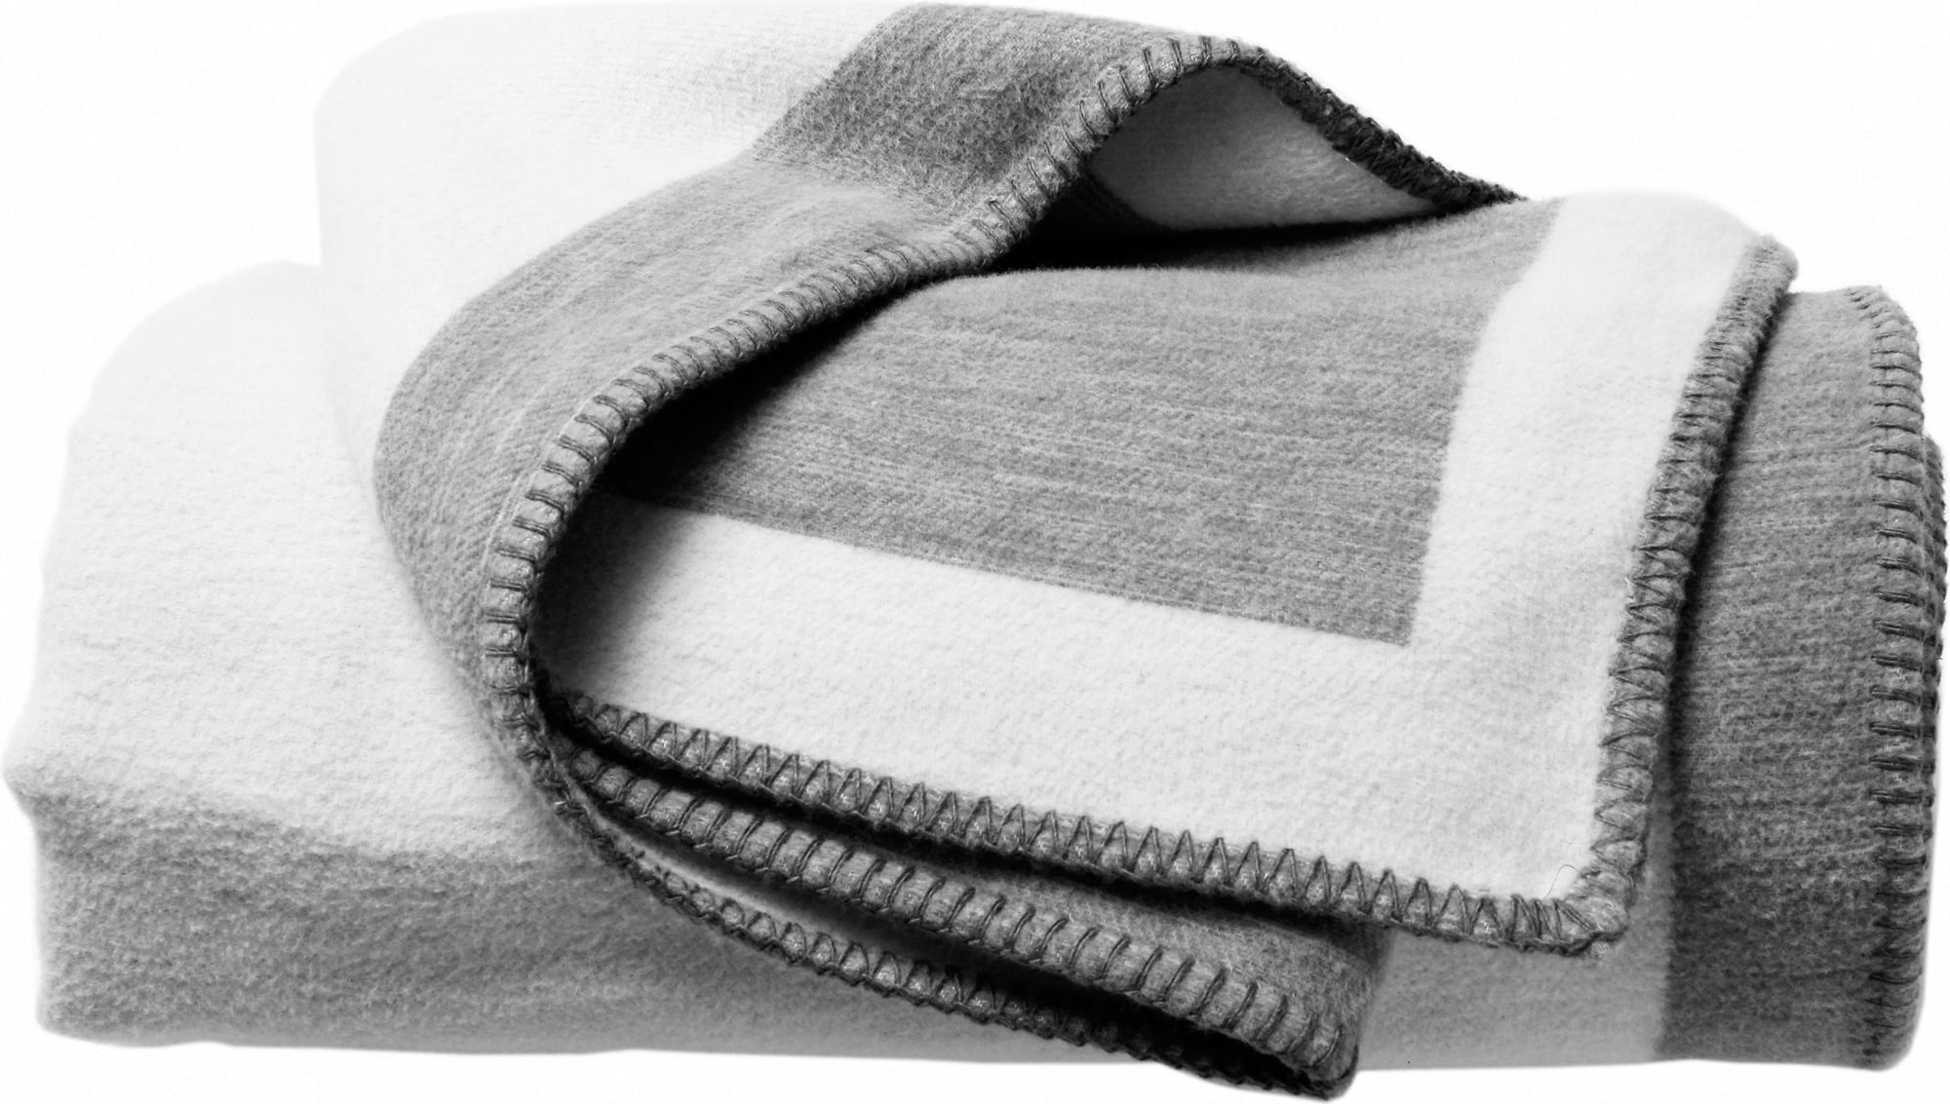
A) How do you say “cobija” in english? B) “cobija”? “I don’t know” Do you know? A) Yes. It is “blanket” b) how do you spell it? A) b – l - a – n – k – e – t B) oh. Ok!

Slide 7
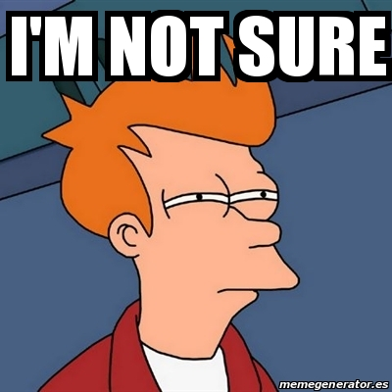

A) How do you say “almohadón” in english? B) “almohadón ”? “I’m not sure” Is it “pillow”? A) No. It is “cushion” b) how do you spell it? A) c – u - s – h – i – o– n B) oh. Ok! And how do you pronounce it? Cu - shion /ku∫ɔn/ sh = / ∫ /

Slide 8
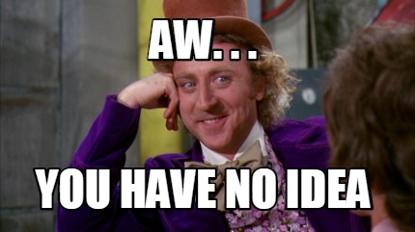
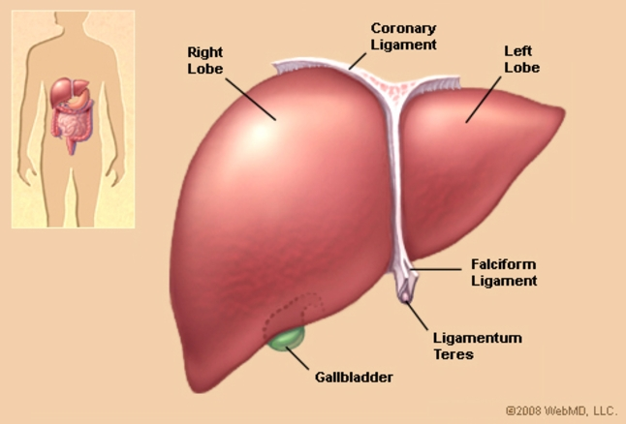
A) How do you say “higado” in english? B) “ higado ”? “I have no idea” Do you know? A) Yes. It is “liver” b) how do you spell it? A) l – i - v – e – r B) oh. Ok! And how do you pronounce it? li - ver / liver /

Slide 9
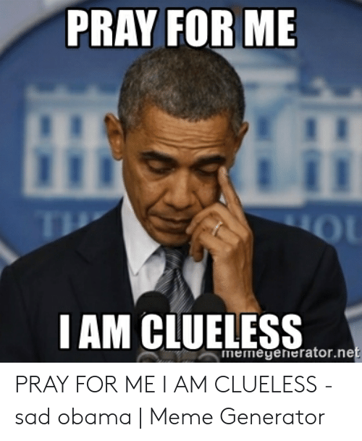

A) How do you say “adorar” in english? B) “ adorar ”? “I am clueless” Do you know? A) Yes. It is “worship” b) how do you spell it? A) w – o - r – s – h – i - p B) oh. I see! And how do you pronounce it? wor - ship / wɔr - ∫ Ip/ sh = / ∫ /

